Slide 1
Quick Start on OpenSpecimen
Shuxin
Jan 6 2025

Slide 2
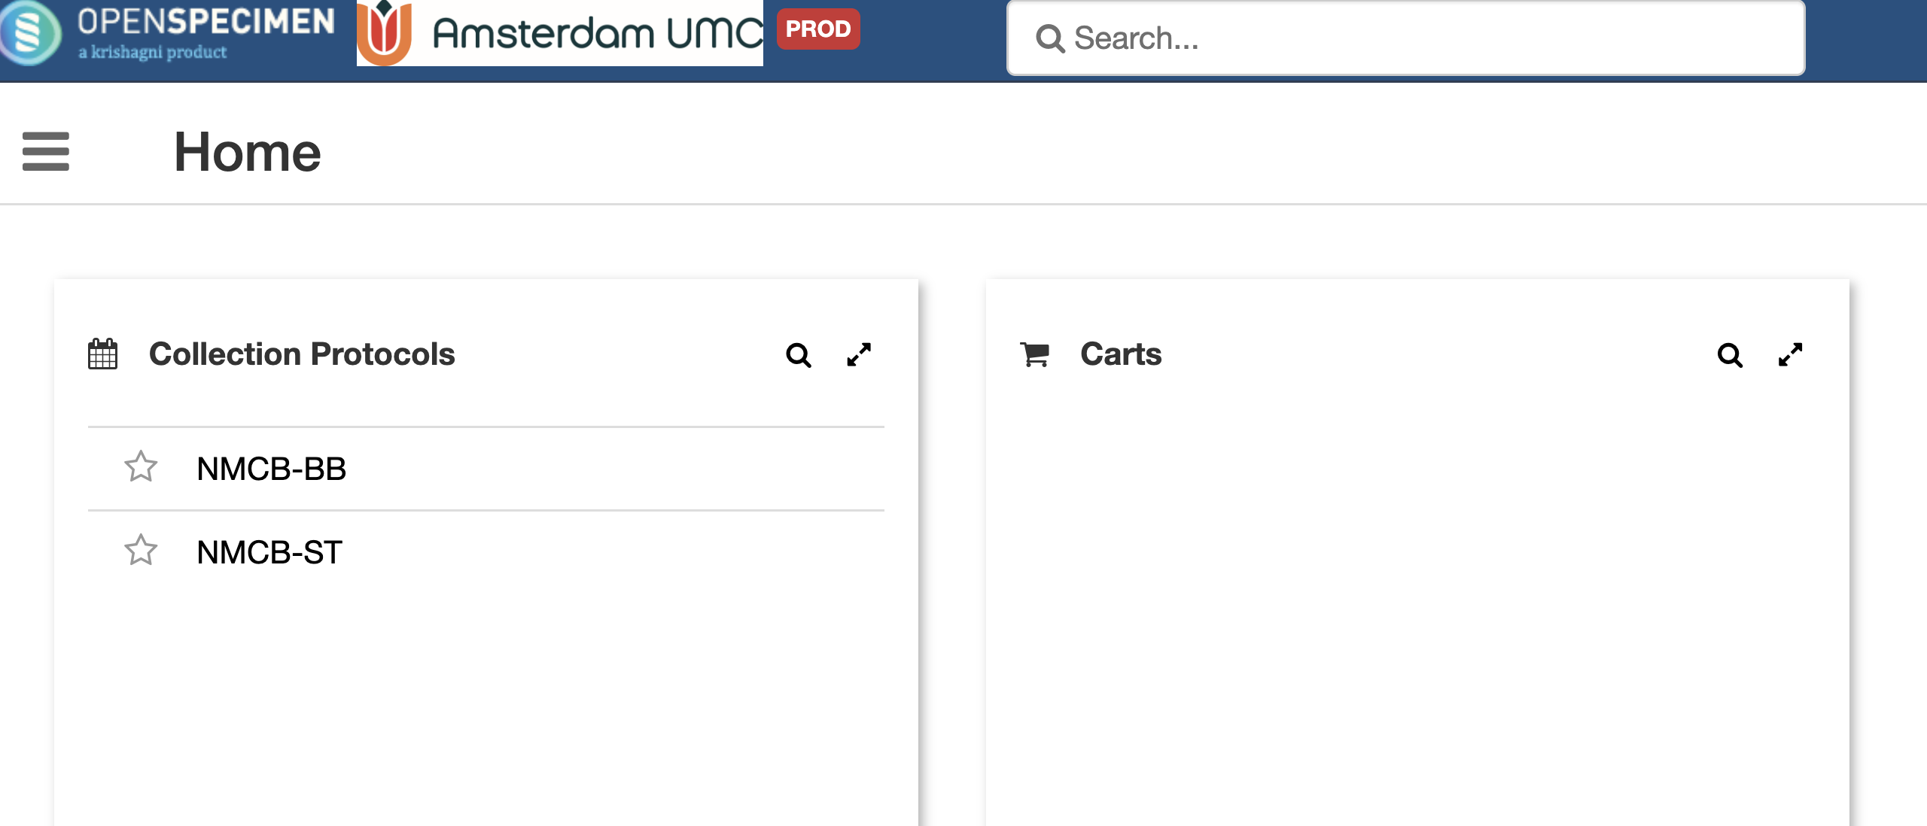
1. Go to NMCB-BB

Slide 3
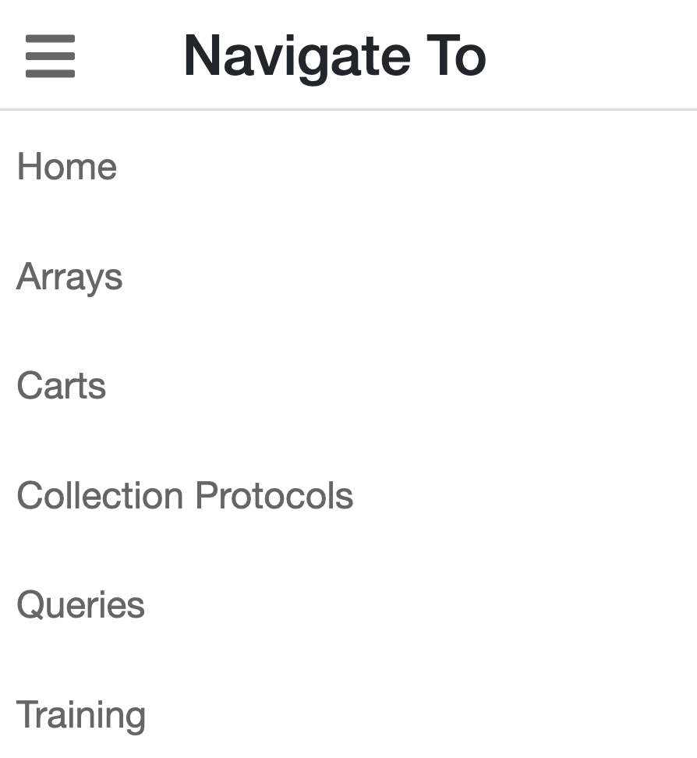
2. Choose “Queries“

Slide 4
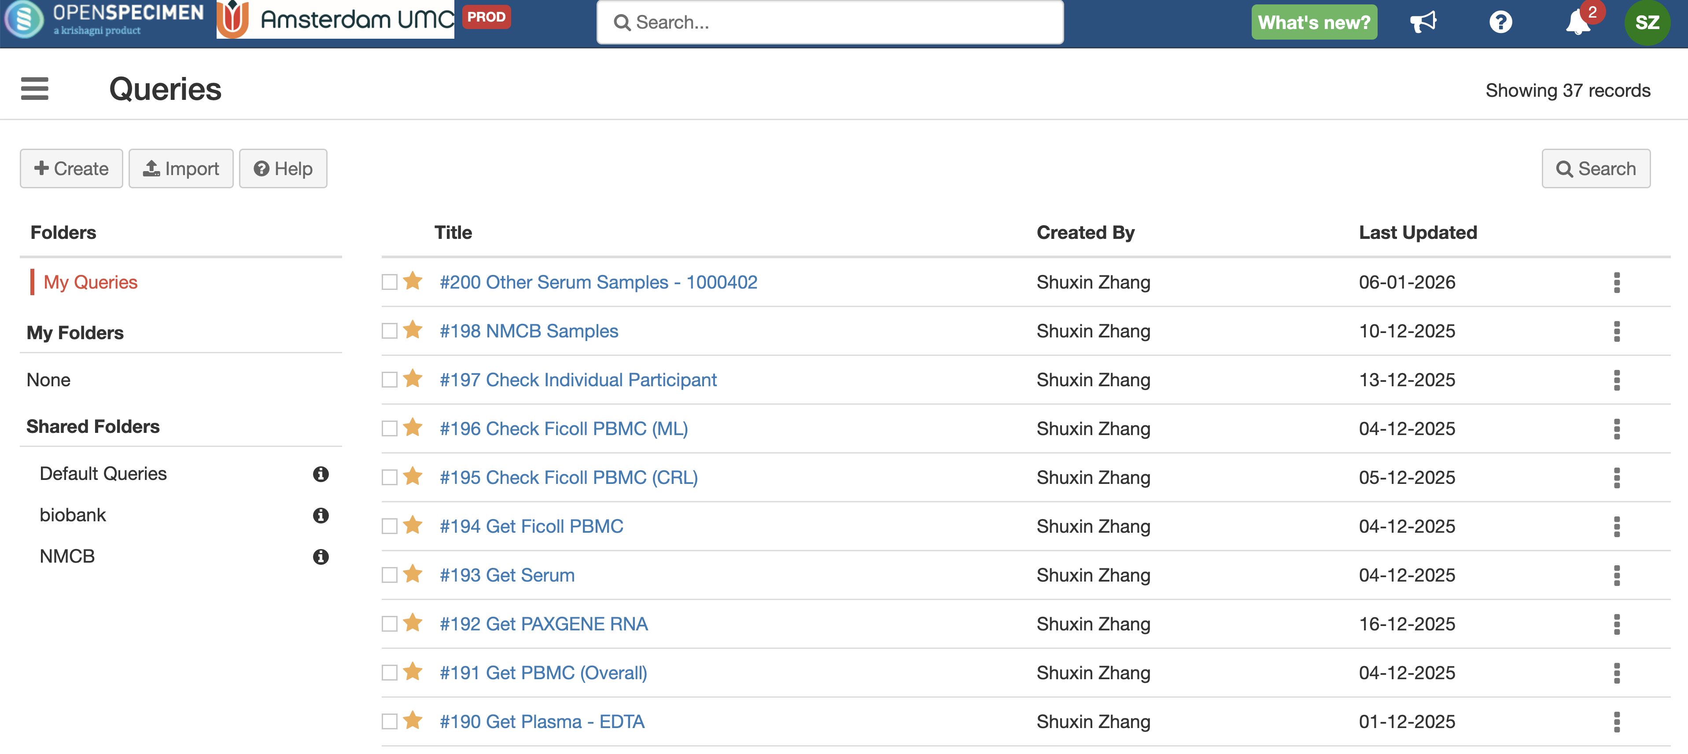
3. I do not know how it looks like in your place. If you could also see thse queries, you could just run mine.
Otherwise, you would have to click ‘Create’ on the top left side.

Slide 5
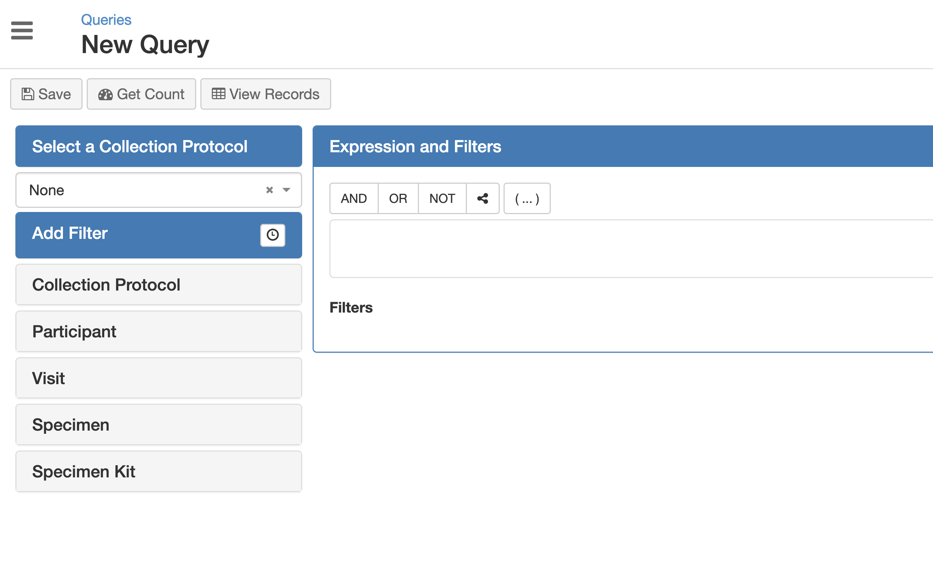
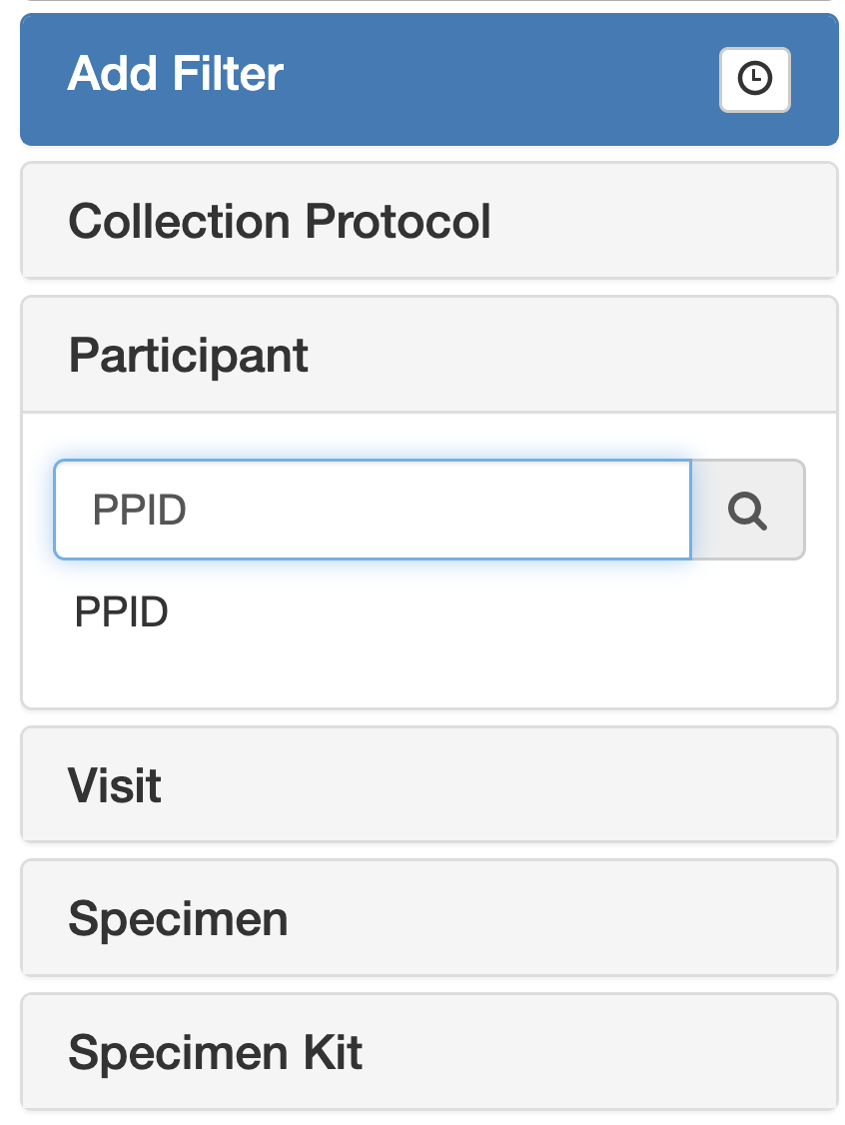
4. There are different groups. But we only use Participant and Specimen
In Participant, only use PPID, which refers to participant ID
In Specimen, we usually use Barcode (refers to aliquot nr), type (refers to sample type).

Slide 6
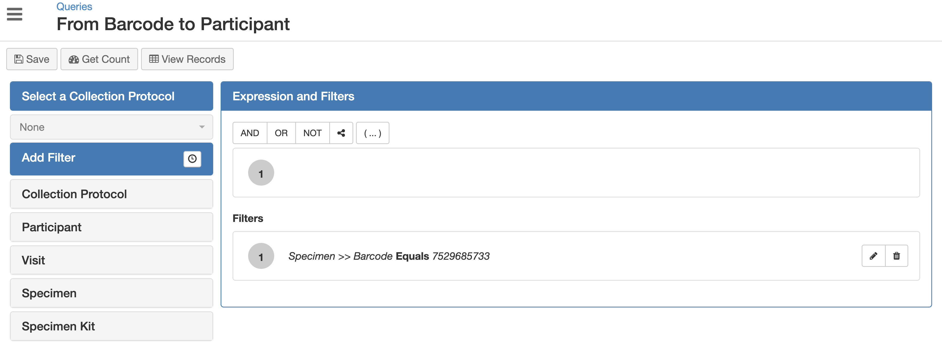
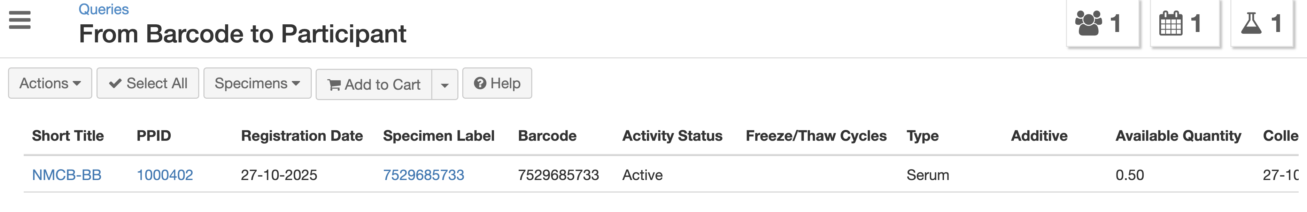
Use Case 1: to find sample info
5. Then click ‘View Records’, and you will see the info below.

Slide 7
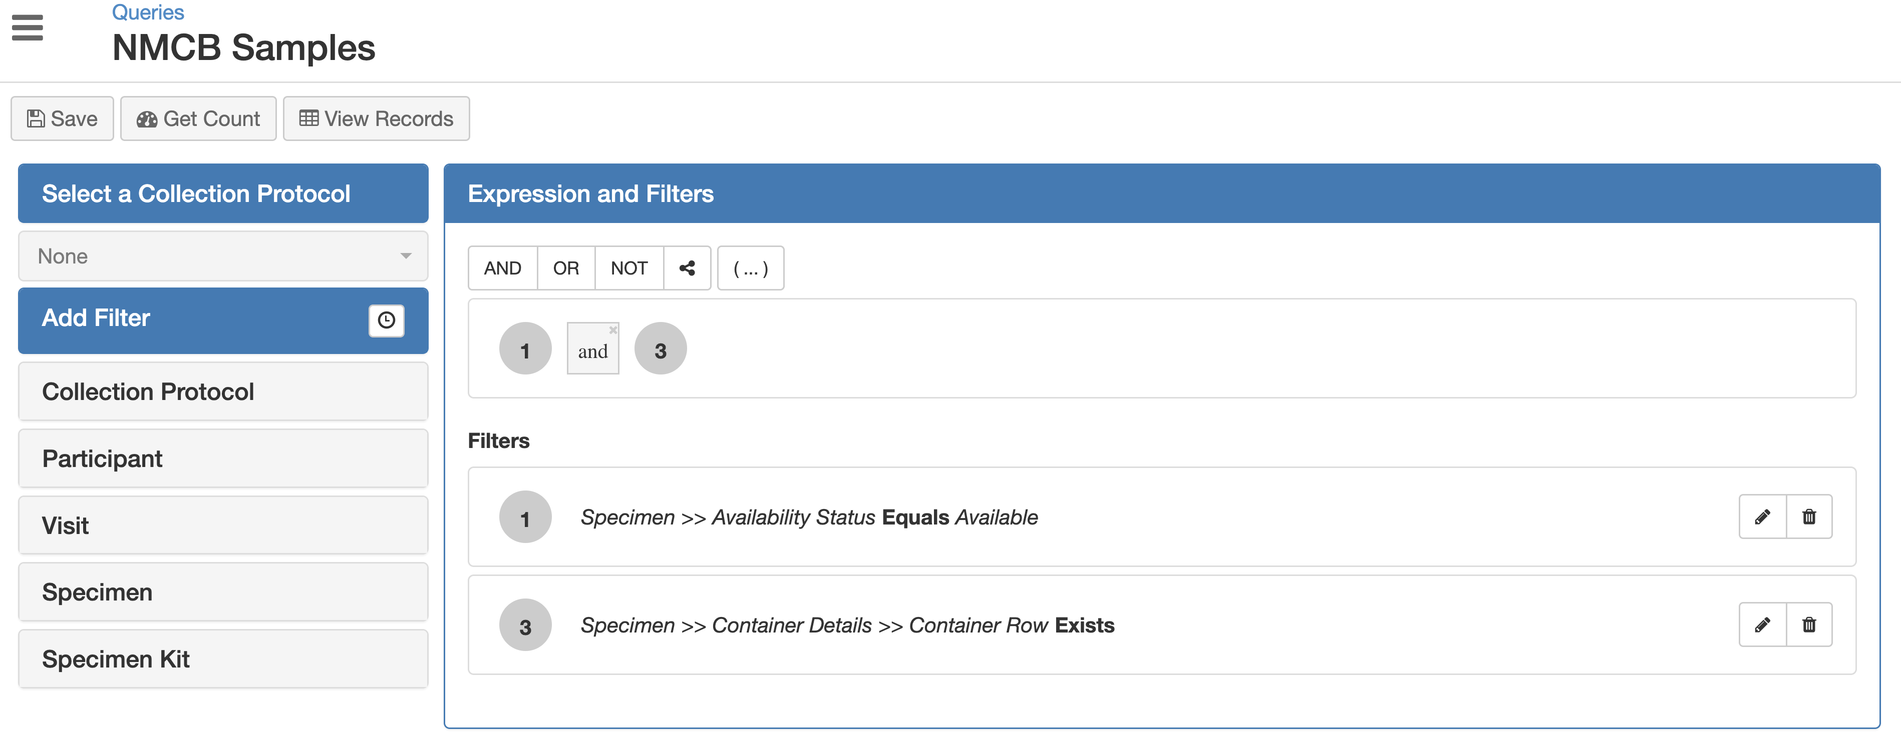
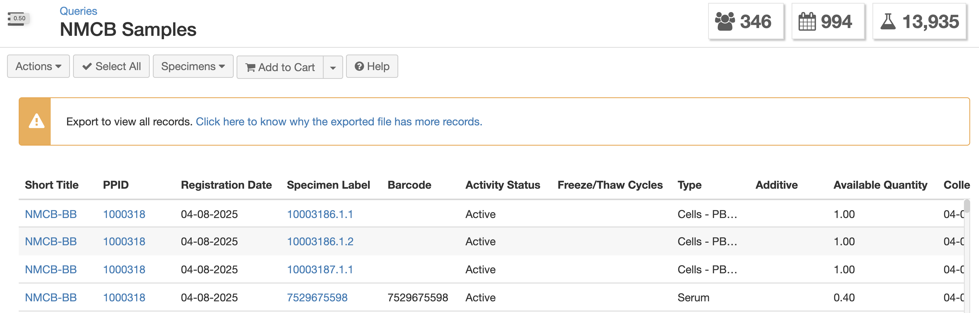
Use Case 2: query all NMCB samples
1. Create query
2. View records

Slide 8
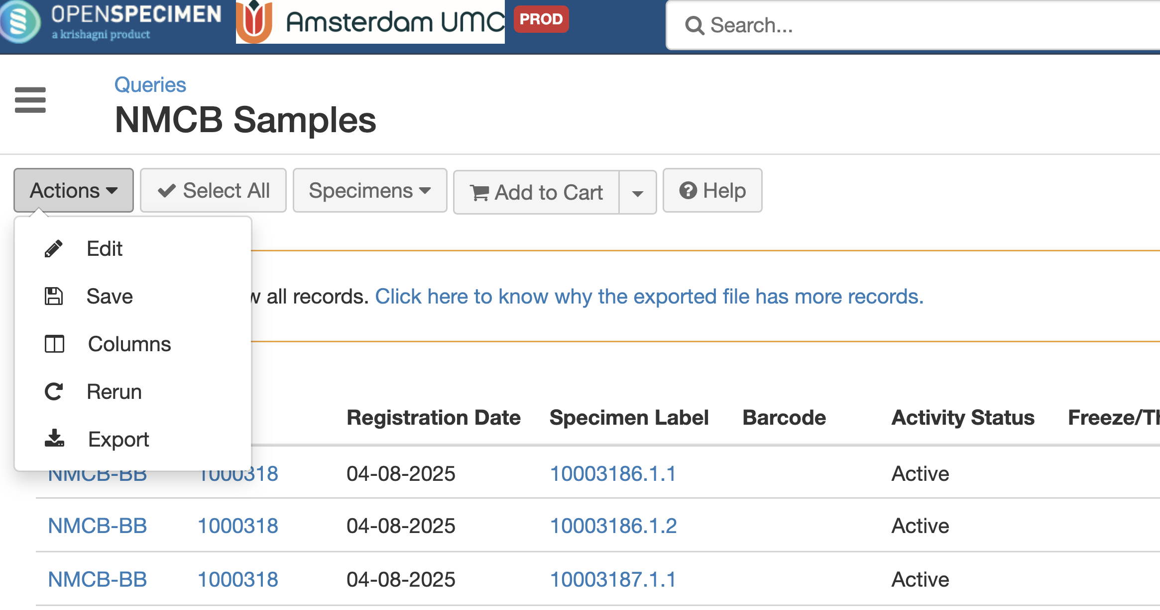
Use Case 2: query all NMCB samples
3. Export
In the export file, you could also find which sample locates to which participant.

